Slide 1


Update for Mind Loops

Slide 2
Public View & Registration Processes

Slide 3
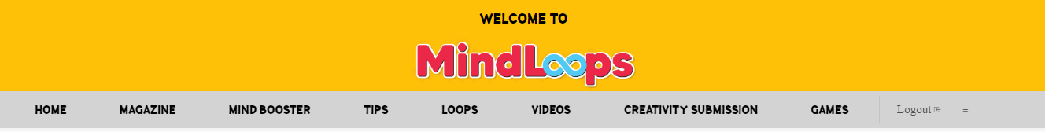
Public View of The Portal
To add one more tab: By Role
By Role will be based on 3 roles:
Teachers
Parents
Students
The menu bar will change according to the role once we have identified the user's category.
Hence, we need a pop-up prompter to ask the visitors to key-in their role. I suggest to add one layer before they surf our portal. The pop-up cannot be close until they have given their role to us.

Slide 4
Limitation of the public view (Teacher)
Teaching Support: They are able to preview the content of the page. Once the user clicks the image/text, we need to prompt action from them to register as a subscriber.
For Loops: They are able to preview the content of the page. They cannot download, cannot read & cannot share. Once the user clicks the image/text, we need to prompt action from them to register as a subscriber.
Tips: They can preview the content of the page. They cannot read, cannot download, cannot share. Once the user clicks the image/text, we need to prompt action from them to register as a subscriber.
Videos: They can preview the vidoes but they cannot watch the video. Once the user clicks the image/text, we need to prompt action from them to register as a subscriber.
Contribute: They cannot upload, create content, or submit their creation unless registered. Once the user clicks the image/text, we need to prompt action from them to register as a subscriber.

Slide 5
Limitation of the public view (Parents)
For Magazine: They are able to preview the monthly issues of the magazine. Once the user clicks the image/text, we need to prompt action from them to register as a subscriber.
For Mind Booster: They are able to preview the subjects, the elements, & preview the content of the elements. They cannot download, cannot read. Once the user clicks the image/text, we need to prompt action from them to register as a subscriber.
Loops: They are able to preview the "Games". Once the user clicks the image/text, we need to prompt action from them to register as a subscriber.
Tips: They are able to preview the "Tips". Once the user clicks the image/text, we need to prompt action from them to register as a subscriber.
Videos: They are able to preview the videos. Once the user clicks the image/text, we need to prompt action from them to register as subscriber.
Creative submissions: They can preview but cannot upload/submit their submission. They need to register first.

Slide 6
Limitation of the public view (Student)
For Magazine: They are able to preview the monthly issues of the magazine. Once the user clicks the image/text, we need to prompt action from them to register as a subscriber.
For Mind Booster: They are able to preview the subjects, the elements, & preview the content of the elements. They cannot download, cannot read. Once the user clicks the image/text, we need to prompt action from them to register as a subscriber.
Loops: They are able to preview the "Games". Once the user clicks the image/text, we need to prompt action from them to register as a subscriber.
Tips: They are able to preview the "Tips". Once the user clicks the image/text, we need to prompt action from them to register as a subscriber.
Videos: They are able to preview the videos. Once the user clicks the image/text, we need to prompt action from them to register as subscriber.
Creative submissions: They can preview but cannot upload/submit their submission. They need to register first.

Slide 7
Mandatory Details Needed (Register Form)
Parents/Guardian
Teachers
*Name:
*Email Address:
*Mobile number:
Confirm Subscription
*Name:
*Email Address:
*Mobile number:
Confirm Subscription
Subscribe now
Subscribe now

Slide 8
Flow for Subscribers

Slide 9
Limitation For Subscribers (Teacher)
Teaching Support: They can access to a limited number of content in the page (limited to 6 content for each item i.e. Pedagogy, Curriculum & Assessment). After they've reached the 6th content, a pop-up will appear to drive action to push "Premium Membership".
For Loops: They can access to a limited number of content in the page (limited to 3 content per item i.e. ready-to-go lessons & resources). After they've reached the 3rd content, a pop-up will appear to drive action to push "Premium Membership".
Tips: They can access to a limited number of content in the page. (Limited to 3 content per item i.e. Classroom Management, Co-curriculum, Counselling). Once they've reached the 3rd content, a pop-up will appear to drive action to push "Premium Membership".
Videos: They can access to a limited number of content in the page. (Limited to 2 content per item i.e. Professional Development, Case Study & Explore). Once they've reached the 2nd content, a pop-up will appear to drive action to push "Premium Membership".
Contribute: They can upload content without any limitation.

Slide 10
Limitation For Subscribers (Parents)
For Magazine: They can read the magazine up to the first 6 months (Jan to June 2023). After they've reached the 6th content or July 2023, a pop-up will appear to drive action to push "Premium Membership".
For Mind Booster: They can click the elements under each subject and access to the content (download, view, & read). The access is limited to 5 usability, comprising of all elements (lesson plans, worksheet, exercises, supplementary notes & quiz). After the 5th times, a pop-up will appear to drive action to push "Premium Membership".
Loops: This is limited to "Premium Memberships".
Tips: They can view & read the content without any limitation
Videos: They can view up to 5 videos before we prompt them to convert as a "Premium Member"
Creative submissions: They can upload the content without any limitation

Slide 11
Limitation For Subscribers (Student)
For Magazine: They can read the magazine up to the first 6 months (Jan to June 2023). After they've reached the 6th content or July 2023, a pop-up will appear to drive action to push "Premium Membership".
For Mind Booster: They can click the elements under each subject and access to the content (download, view, & read). The access is limited to 5 usability, comprising of all elements (lesson plans, worksheet, exercises, supplementary notes & quiz). After the 5th times, a pop-up will appear to drive action to push "Premium Membership".
Loops: This is limited to "Premium Memberships".
Tips: They can view & read the content without any limitation
Videos: They can view up to 5 videos before we prompt them to convert as a "Premium Member"
Creative submissions: They can upload the content without any limitation

Slide 12
Mandatory Details Needed (Premium Membership)
Parents/Guardian
Teachers
*Payment Method:
*Name on Card:
*Billing Address:
*Remember this card:
*Tax-exemption:
Confirm Membership
*Payment Method:
*Name on Card:
*Billing Address:
*Remember this card:
*Tax-exemption:
Confirm Membership
Become a member
Become a member

Slide 13
Premium Access

Slide 14
Access For Subscribers (Teacher)
Teaching Support: They can have the full access
For Loops: They can have the full access
Tips: They can have the full access
Videos: They can have the full access
Contribute: They can have the full access

Slide 15
Access For Subscribers (Parents)
Magazine: They can have the full access
Mind Booster: They can have the full access
Loops: They can have the full access
Tips: They can have the full access
Videos: They can have the full access
Creative submissions: They can have the full access

Slide 16
Access For Subscribers (Students)
Magazine: They can have the full access
Mind Booster: They can have the full access
Loops: They can have the full access
Tips: They can have the full access
Videos: They can have the full access
Creative submissions: They can have the full access

Slide 17
Ads Placement

Slide 18
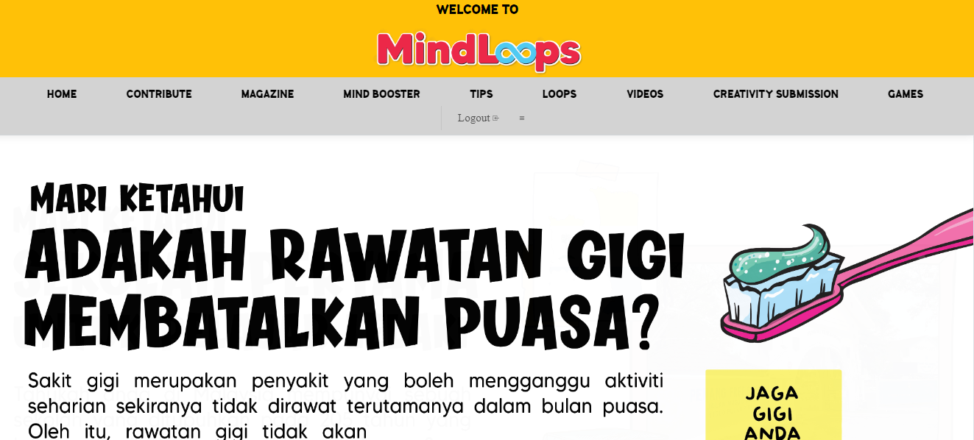
Home Page – Large Leaderboard
LARGE LEADERBOARD (980 px w x 90 px h) Format:JPEG/GIF.

Slide 19
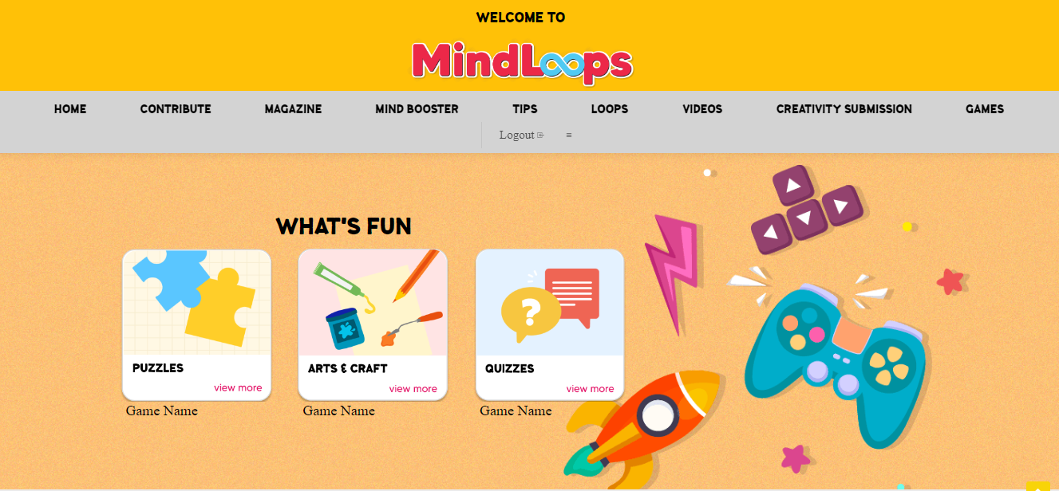
Home Page – Square Ad
SQUARE AD:
250 w px x 250 h px
Format: JPEG/GIF.

Slide 20
Home Page – Sticky Footer ad
Footer Ad: 728 px w x 90 h px. Format: JPEG/GIF. Running on site (ROS) - appear across the portal.

Slide 21
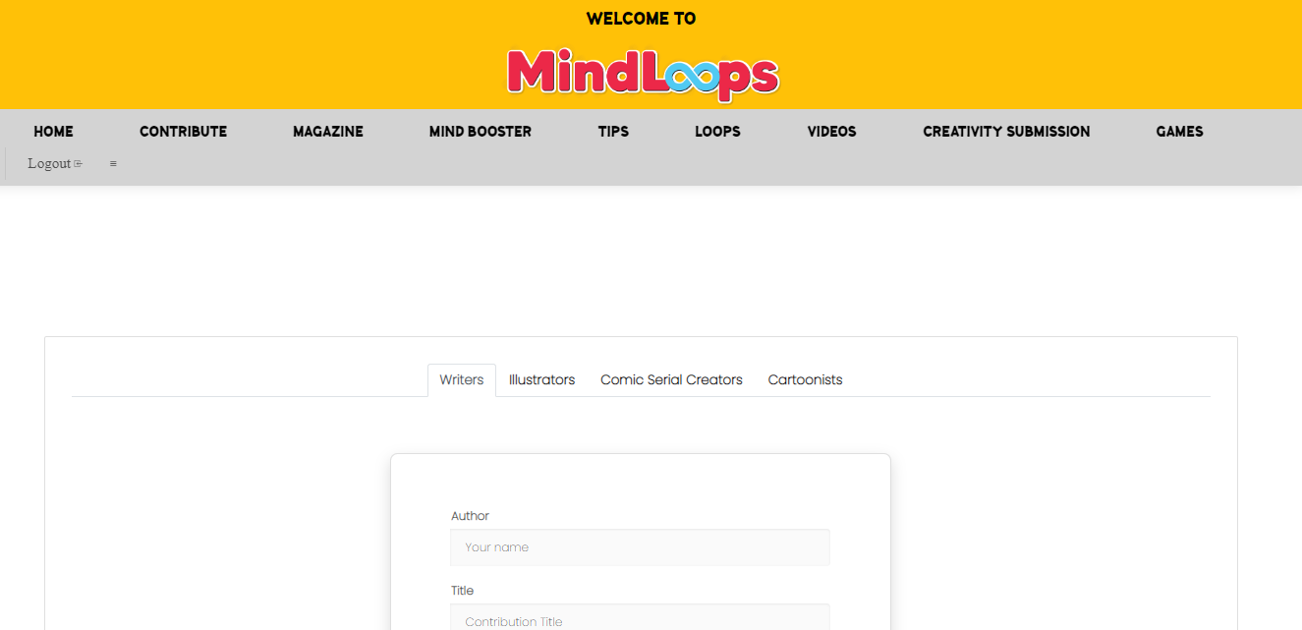
Contribute – Large Leaderboard & Skyscrapper ad
LARGE LEADERBOARD (980 px w x 90 px h) Format:JPEG/GIF.
SKYSCRAPPER AD
120 (w) px x 600 (h) px
Format: JPEG/GIF
Footer Ad: 728 px w x 90 h px. Format: JPEG/GIF. Running on site (ROS) - appear across the portal.

Slide 22
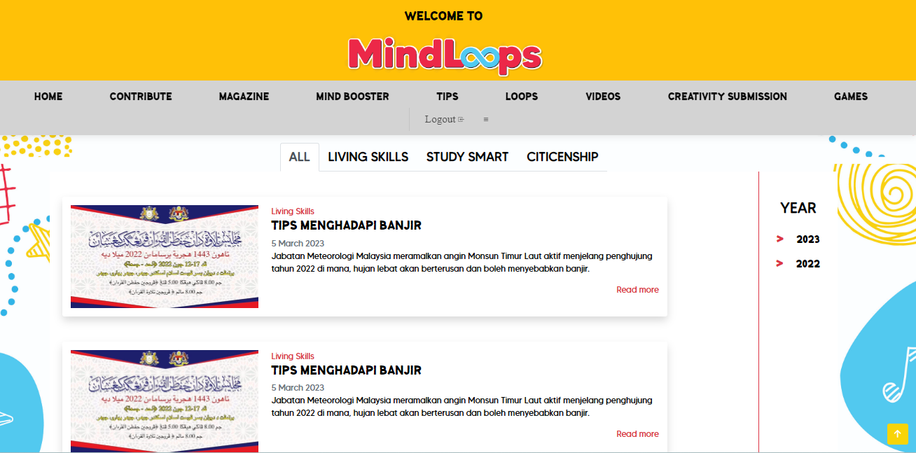
Tips Ad – Large Leaderboard & Sky scrapper
LARGE LEADERBOARD (980 px w x 90 px h) Format:JPEG/GIF.
SKYSCRAPPER AD
120 (w) px x 600 (h) px
Format: JPEG/GIF
Footer Ad: 728 px w x 90 h px. Format: JPEG/GIF. Running on site (ROS) - appear across the portal.

Slide 23
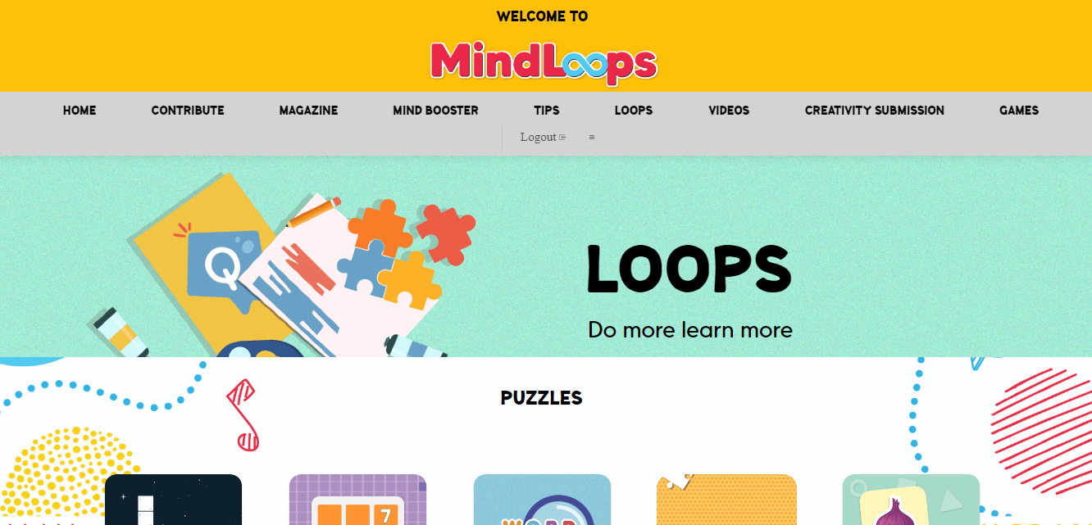
Loops Ad – Large Leaderboard & Sky scrapper
LARGE LEADERBOARD (980 px w x 90 px h) Format:JPEG/GIF.
SQUARE AD:
250 w px x 250 h px
Format: JPEG/GIF.
Footer Ad: 728 px w x 90 h px. Format: JPEG/GIF. Running on site (ROS) - appear across the portal.

Slide 24
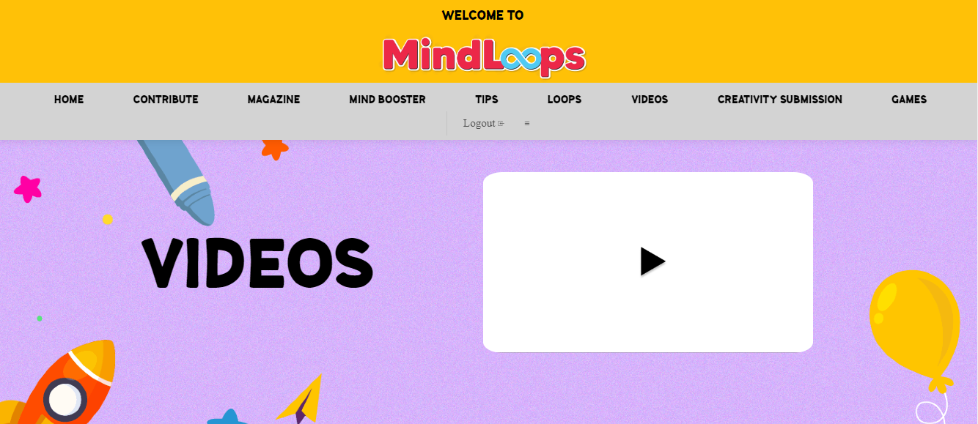
Video Ad – Large Leaderboard & Footer
LARGE LEADERBOARD (980 px w x 90 px h) Format:JPEG/GIF.
SQUARE AD:
250 w px x 250 h px
Format: JPEG/GIF.
Footer Ad: 728 px w x 90 h px. Format: JPEG/GIF. Running on site (ROS) - appear across the portal.

Slide 25
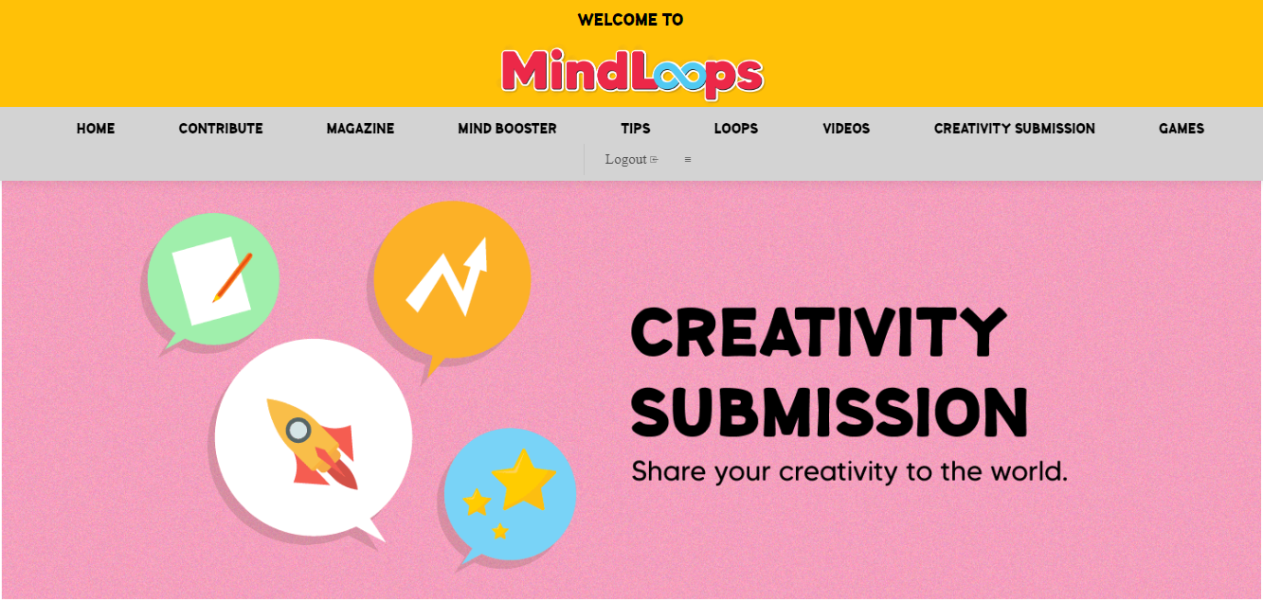
Creativity Submission – Large Leaderboard & Footer Ad
LARGE LEADERBOARD (980 px w x 90 px h) Format:JPEG/GIF.
SQUARE AD:
250 w px x 250 h px
Format: JPEG/GIF.
Footer Ad: 728 px w x 90 h px. Format: JPEG/GIF. Running on site (ROS) - appear across the portal.

Slide 26
Site Map & Flow by Roles

Slide 27

Teachers
Teaching Support
Loops
Tips
Videos
Contribute
Pedagogy
Ready-to-go Lessons
Counselling
Professional Development
Curriculum
Resources
Classroom Management
Explore
Assessment
Co-curriculum
Case Study

Slide 28
Parents
Loops
Tips
Videos
Contribute
Creativity Submission
Teaching
Resources
Children
Parenting
Children
Activities
Teen
Explore
Mine
Skills
Tutoring
Family Games
Bonding

Slide 29
Legend:
General Knowledge: GK
Standard: S (Darjah)
Lower primary: LP (Darjah 1,2,3)
Upper primary: UP (Darjah 4,5,6)
Students
Loops
Tips
Videos
Creativity Submission
Mind Booster
GK
LP
General Knowledge
GK
Puzzles
Study Smart
D.I.Y
GK
UP
GK
Bahasa Malaysia
S
Arts & Crafts
LP
Living Skills
Explore
English
S
GK
S
UP
Mathematics
S
Quizzes
LP
Citizenship
Lessons
GK
S
UP
Science
S
Islamic Studies
S

Slide 30
Content For Mind Booster

Slide 31
Arrangement of Subjects
Mind Booster
General Knowledge
Bahasa Melayu
English
Islamic Studies
Science
Mathematics

Slide 32
Content For Each Subjects & Flow For First 3 Elements
Topic 1 (Unique Identifier)
Elements to include on the side bar
Clickable image > leads to a preview of the content > Call To Action (Download)
Clickable image > leads to a preview of the content > Call To Action (Download)
Clickable image > leads to a preview of the content > Call To Action (Download)
Lesson Plans
Worksheet
Supplementary notes
Exercises
Quizzes
Title
Subtitle
Description
Preview Download
Title
Subtitle
Description
Preview Download
Title
Subtitle
Description
Preview Download

Slide 33
Flow For Last 2 Elements
Topic 1
Topic 1 (Unique Identifier)
Elements to include on the side bar
Clickable image > leads to a preview of the content > Call To Action (Do activity i.e. quiz & exercises)
Clickable image > leads to a preview of the content > Call To Action (Do activity i.e. quiz & exercises)
Clickable image > leads to a preview of the content > Call To Action (Do activity i.e. quiz & exercises)
Lesson Plans
Worksheet
Supplementary notes
Exercises
Quizzes
Title
Subtitle
Description
Preview *CTA
Title
Subtitle
Description
Preview *CTA
Title
Subtitle
Description
Preview *CTA
Note: *CTA refers to the activity of the specific element. If the user chooses quiz, the CTA will be "Take Quiz" and "Take Exercises" for the test element.

Slide 34
Thank you!

